Slide 1
Flex Box
Flex Box Containers and Items | Flex Container Properties | Flex Box Properties | Flex Property
Notes:
Welcome to out lecture on CSS flex box. In this lecture we will go through flex box container and items, flex container properties, flex box properties, and flex property. Let’s start our lecture.

Slide 2

Flex Box Containers and Items
Flexbox: A CSS layout mode for responsive and efficient element alignment.
Flex container: Created with display: flex (block) or display: inline-flex (inline), holding flex items.
Flex items: Child elements of a flex container, positioned and sized using flexbox properties.
Notes:
Flexbox is a CSS layout mode designed to create responsive and efficient element alignment. A flex container is the parent element where the flexbox layout is applied using display flex for block level or inline flex for inline containers. Flex items are the child elements within the container, positioned and sized dynamically based on flexbox properties to achieve flexible layouts.

Slide 3
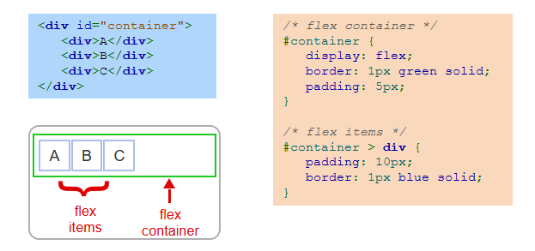
Flex Box Example
Notes:
This example demonstrates a flexbox layout. The flex container is defined using the display flex property applied to the container element. It includes styles such as border and padding for visual clarity. Inside the container, flex items are styled individually, with padding and borders applied. The layout ensures the items align within the container dynamically using the flexbox rules.

Slide 4
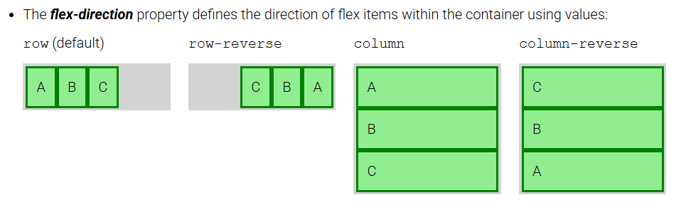
Flex Container Properties
Several CSS properties modify the default behavior of a flex container:
Notes:
Now move to flex container properties. The flex-direction property controls the direction of flex items within a flex container. It has four possible values: row, the default, arranges items horizontally; row reverse flips the order horizontally; column arranges items vertically; and column reverse flips the order vertically. These options allow for flexible alignment of items based on the desired layout.

Slide 5
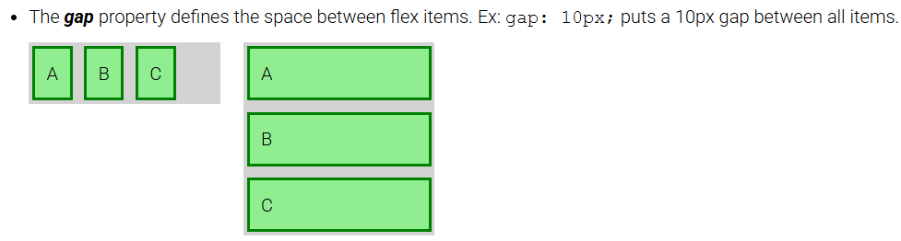
Flex Container Properties
Notes:
Next property is gap. The gap property in CSS flexbox defines the space between flex items within a container. It allows for clean and consistent spacing without adding margins to individual items. For example, using gap 10px adds a 10-pixel space between all flex items, both horizontally and vertically, depending on the layout direction. This simplifies spacing and enhances the overall appearance of the layout.

Slide 6
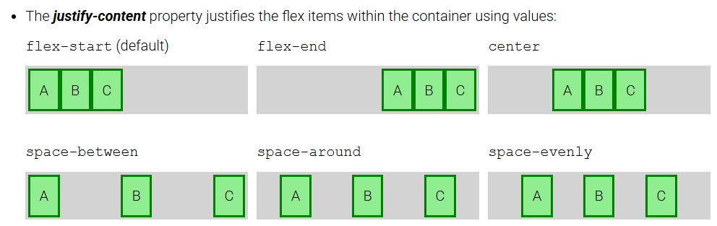
Flex Container Properties
Notes:
Third property is justify-content. The justify-content property aligns flex items within a container along the main axis. Common values include flex-start, the default, which aligns items at the start, and flex-end, aligning them at the end. Center places items in the middle, space-between distributes items with space between them, space-around adds space around items, and space-evenly ensures equal spacing between and around items.

Slide 7
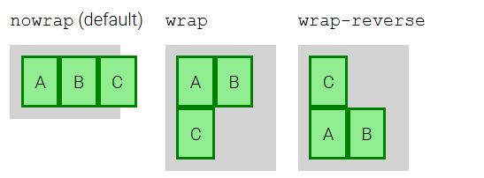
Flex Container Properties
The flex-wrap property determines if or how flex items wrap onto multiple rows when the container is not wide enough to hold all items, using values:
Notes:
Last property is flex wrap. The flex-wrap property controls whether flex items wrap onto multiple rows or columns when the container is too small. The default value no wrap keeps items in a single line. The wrap value allows items to move onto new rows or columns as needed. The wrap-reverse value also wraps items but in the reverse order, starting from the bottom or opposite side of the container.

Slide 8
Flex Item Properties
A flex item's width is determined by the combination of three CSS properties:
flex-basis: Sets the initial size of a flex item. Accepts auto (default), percentages, or length units. With auto, the size matches the content.
flex-grow: Determines how much extra space a flex item takes when the container has free space. Default is 0 (no growth).
flex-shrink: Controls how much a flex item shrinks when the container is smaller than its contents. Default is 1 (shrinks proportionally); 0 prevents shrinking.
Notes:
Next concept is properties of flex item. A flex item's width is defined by three CSS properties. Flex-basis sets the initial size, using values like auto, percentages, or units. Flex-grow determines how much extra space the item takes when the container has free space, with 0 as the default. Flex-shrink controls how the item shrinks when the container is smaller, with 1 as the default for proportional shrinking and 0 to prevent shrinking.

Slide 9
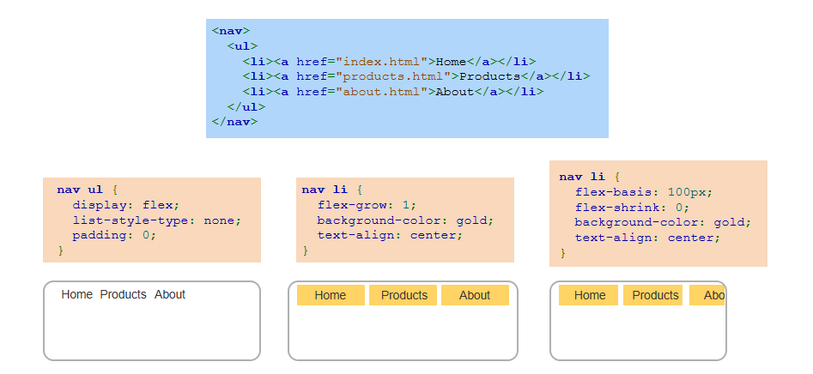
Example
Notes:
This example demonstrates a navigation menu styled using flexbox. The UL element is set as a flex container with display flex, removing list styles and padding. The LI items are flex items. Using flex-grow 1, the items equally share available space. Flex-basis 100px sets an initial width for the items, while flex-shrink 0 prevents shrinking. This layout ensures a responsive and consistent menu design.

Slide 10
The Flex Property
Flex shorthand property: The flex property combines three individual flexbox properties—flex-grow, flex-shrink, and flex-basis—into one. This simplifies the CSS code for defining how a flex item behaves within a container.
Example usage: flex: 0 1 auto; is equivalent to setting flex-grow: 0;, flex-shrink: 1;, and flex-basis: auto;, where the item doesn’t grow, shrinks proportionally, and starts with a size based on its content.
Notes:
The flex shorthand property simplifies CSS by combining flex-grow, flex-shrink, and flex-basis into one. For example, flex 0 1 auto is equivalent to flex-grow 0, flex-shrink 1, and flex-basis auto. This means the item does not grow, shrinks proportionally when space is limited, and starts with a size based on its content. This shorthand makes defining item behavior within flex containers more efficient.

Slide 11
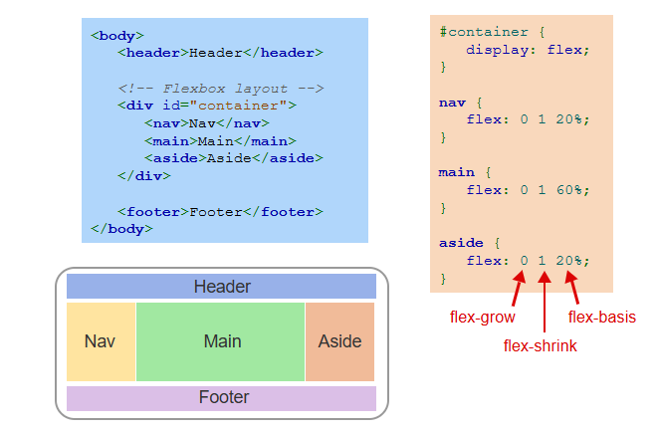
Example
Notes:
This example shows a flexbox layout with a container that holds nav, main, and aside elements. The container uses display flex to align its children. The nav and aside elements have flex 0 1 20 percent, meaning they do not grow, shrink proportionally, and take 20 percent of the space. The main element has flex 0 1 60 percent, taking 60 percent of the space, ensuring a responsive structure. Thanks for watching the lecture.

